Slide 1
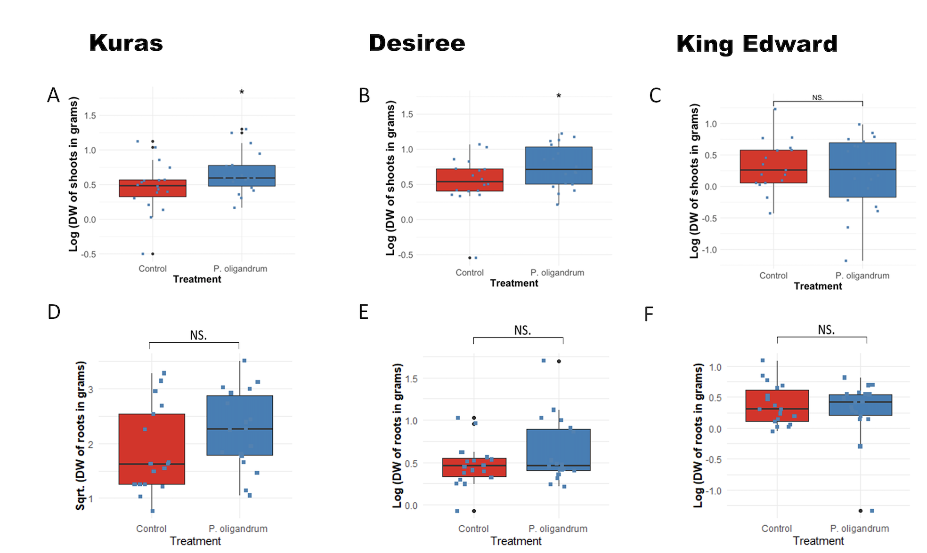
S.F.1 A-F. Boxplots of biostimulation of potato plants treated with P. oligandrum (blue boxplots) or untreated controls (red boxplots), in the three different genotypes Kuras, Desirée, King Edward, in greenhouse bioassays. (A-C), logarithmic transformation of dry weight of the potato shoots in grams at the end of the experiment. A, cv. Kuras and B, cv. Desiree and C, King Edward. (D-F), square root transformed dry weight of roots of the potato roots. In D, cv. Kuras and E, cv. Desiree and F, King Edward. The potato plants were either untreated control plants or treated with P. oligandrum. Significant difference (p < 0.05) is indicated with an asterisk. The total number of plants used per treatment was n=6. The experiment was repeated three individual times.

Slide 2
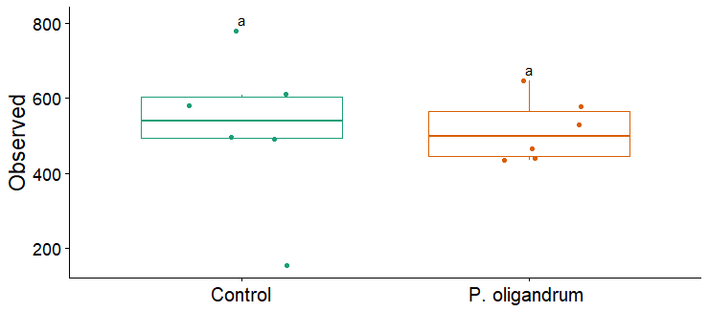
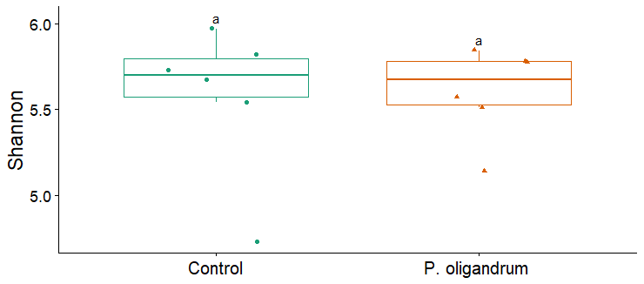
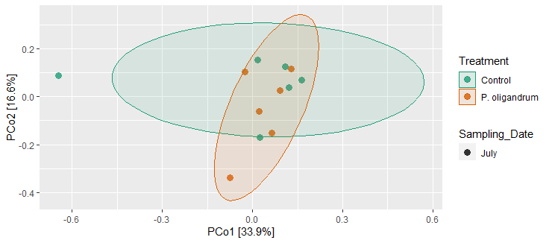
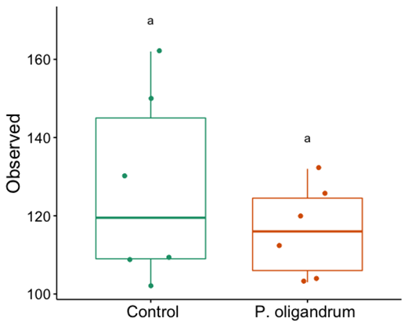
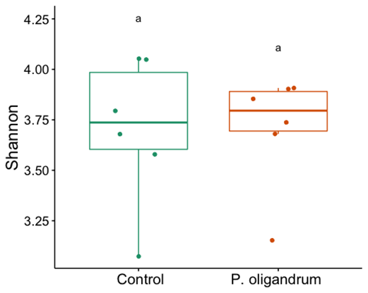
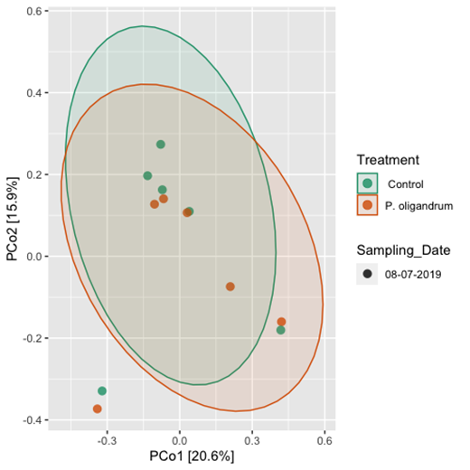
Bacteria
A
B
C
08-07-19
Fungi
D
E
F
S.F.2. Comparison of the two to be treated groups in microbiome composition. A & D, Anova comparison of the Observed ASV between the “control” group and ”P.oligandrum” treated group in Bacteria and fungal microbiome respectively. B & E alpha-diversity computed as Shannon index between the two groups. C & F beta-diversity comparison between the two groups. Asterix would indicate significant differences with (p <0.05)

Slide 3
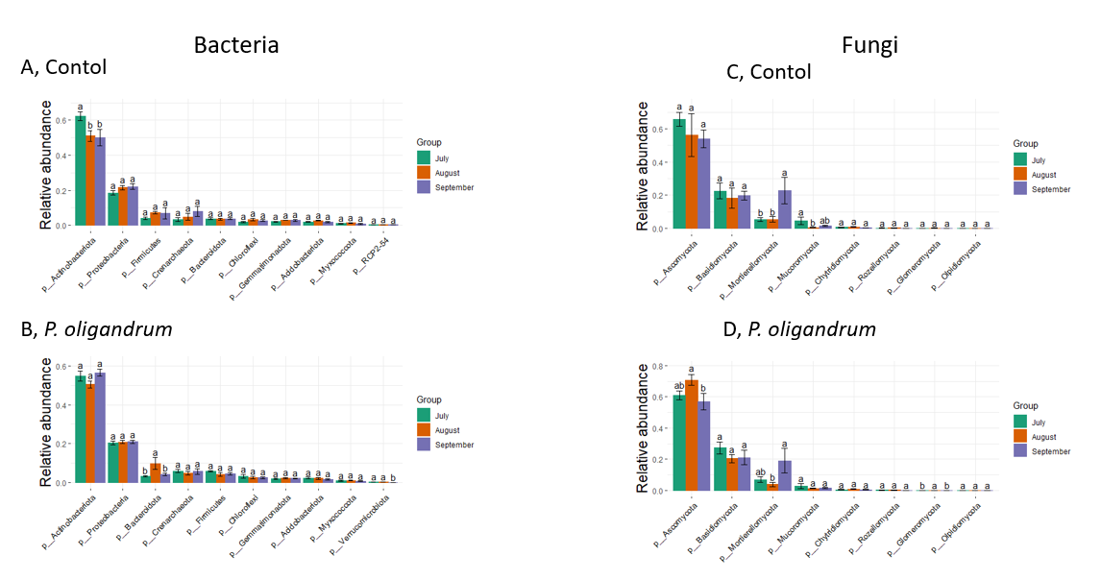
A, Control
C, Control
S.F. 3, A-D. Temporal change in mean relative abundance of top 10 Bacteria (A & B) and 8 fungal phyla (C & D). Different letters indicate significant difference detected with one way ANOVA with significance accepted if (p < 0.05).

Slide 4
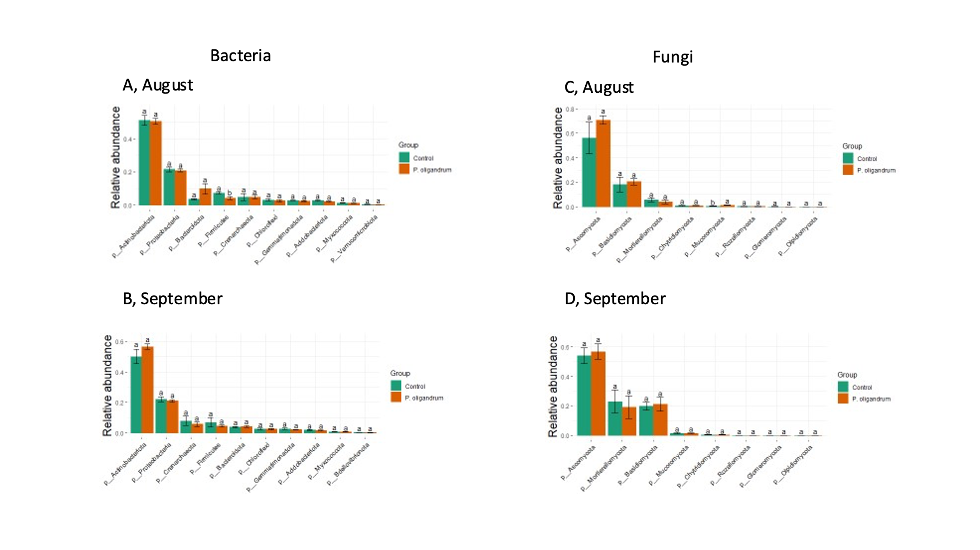
S. F. 4, A-D. Comparison of the relative abundance of top 10 bacteria and 8 fungal phyla between untreated control plants and P. oligandrum treated plants in the rhizosphere microbiome of cv. Kuras potato plants in a small-scale field trial. (A) and (C) at the August timepoint and (B) and (D) in September. letters indicate significant difference detected with one way ANOVA with significance accepted if (p < 0.05).

Slide 5
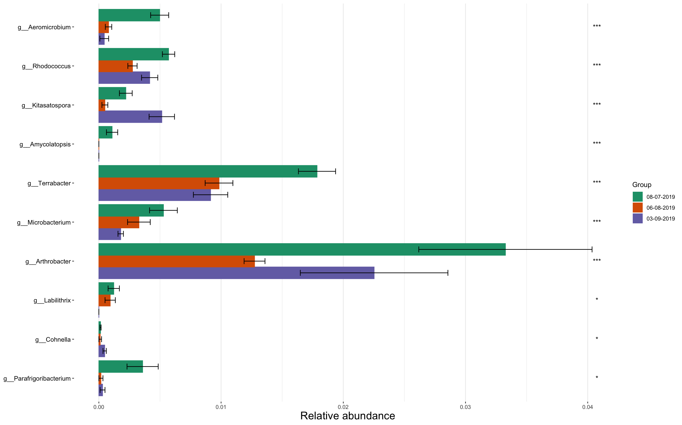
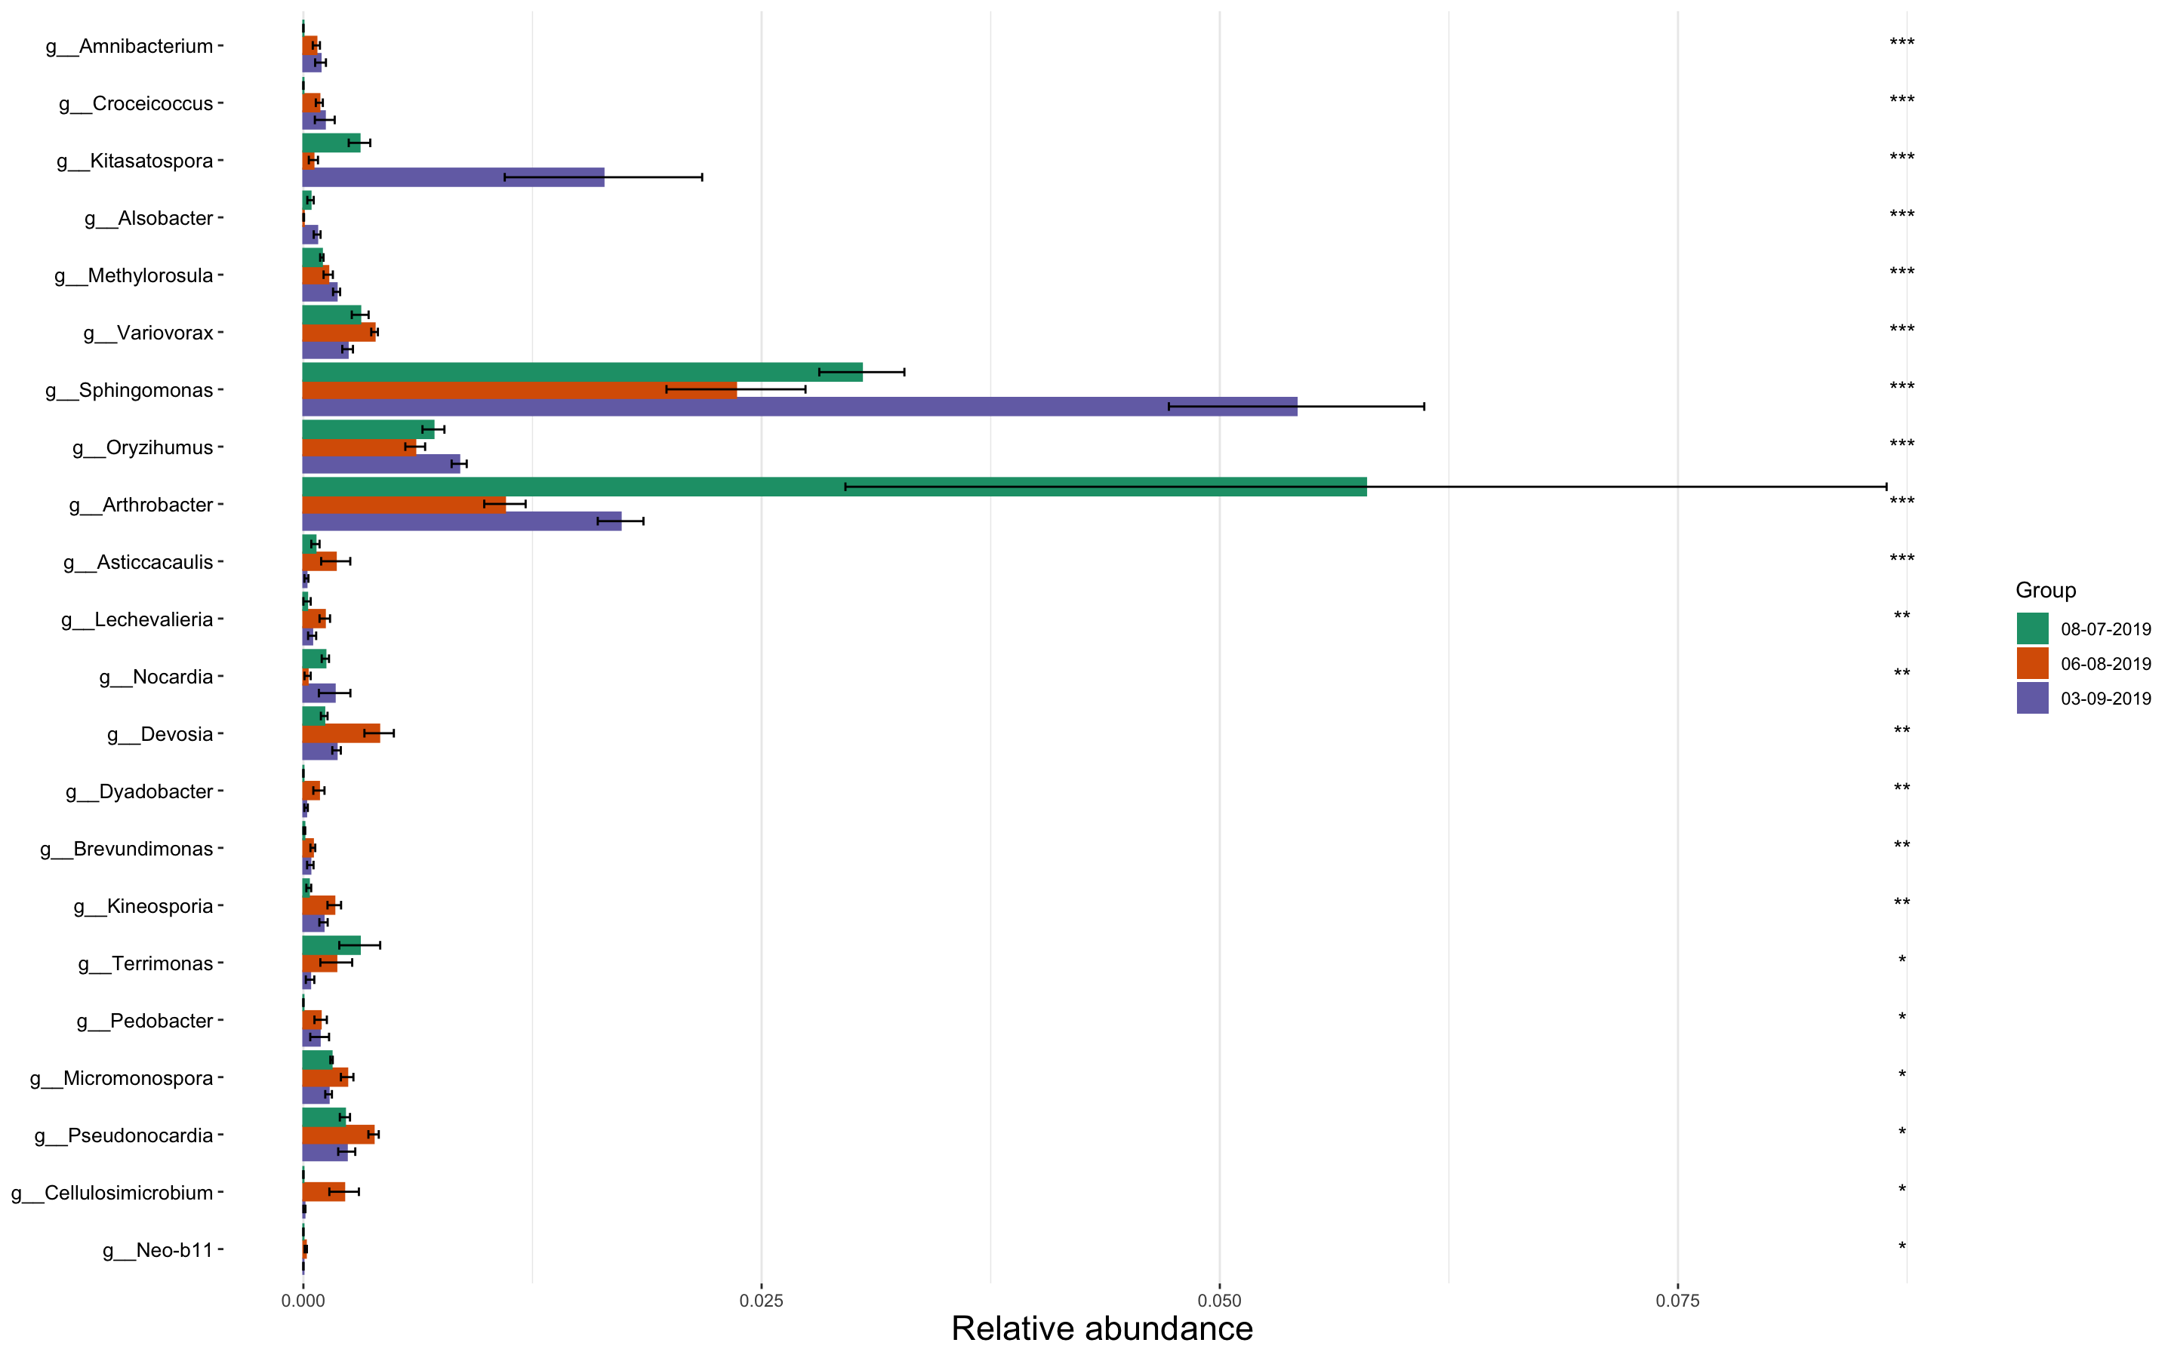
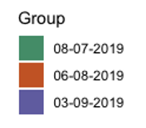
Bacteria
S.F.5, A-B. Relative abundance of the fungal differential abundant genera over time. A, relative abundance of bacteria differential abundant genera in the control plants. B, relative abundance of bacteria differential abundant genera in the P.oligandrum treated plants. Asterix indicates significant difference with (p<0.05), using ANCOMBC global test

Slide 6
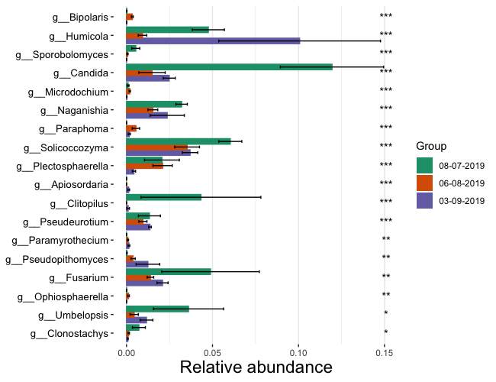
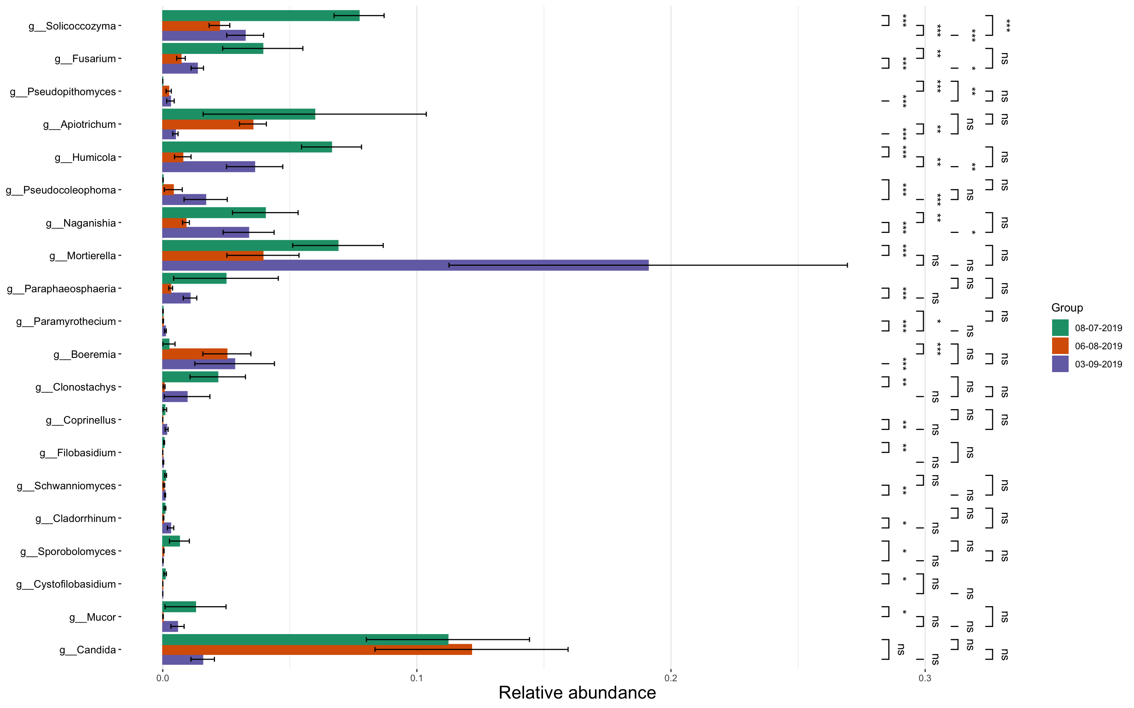

Fungi
A. Control plants
B. P. oligandrum
S.F.6, A-B. Relative abundance of the fungal differential abundant genera over time. A, relative abundance of fungal differential abundant genera in the control plants. B, relative abundance of fungal differential abundant genera in the P.oligandrum treated plants. Asterix indicates significant difference with (p<0.05), using ANCOMBC global test.

